Slide 1
Legal Matters Terms and Their Definitions.
Created by David Nall

Slide 2
Accessory
One who participates knowingly and voluntarily in commission of a crime.
This can be before or after the fact.
The accessory need not be present at the crime scene to be held accountable.

Slide 3
Conspiracy
When two or more individuals agree to or set up an unlawful act by agreement and with intent on carrying the act out.
Most U.S. jurisdictions require at least one illegal act to charge a group of people with conspiracy.

Slide 4
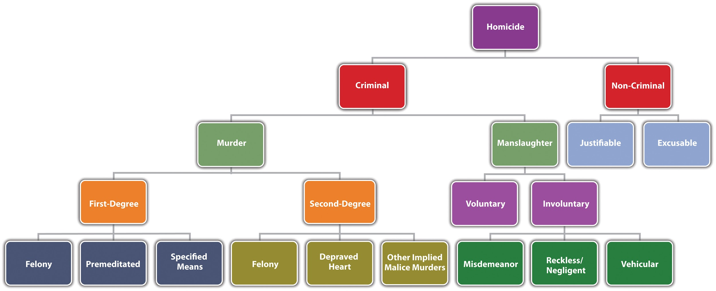
Manslaughter
The unlawful killing of another person without ‘malice aforethought’ or the serious intent to kill and disregard for human life before the act was committed.
Manslaughter carries less moral blame than Murder or Second Degree Murder.

Slide 5
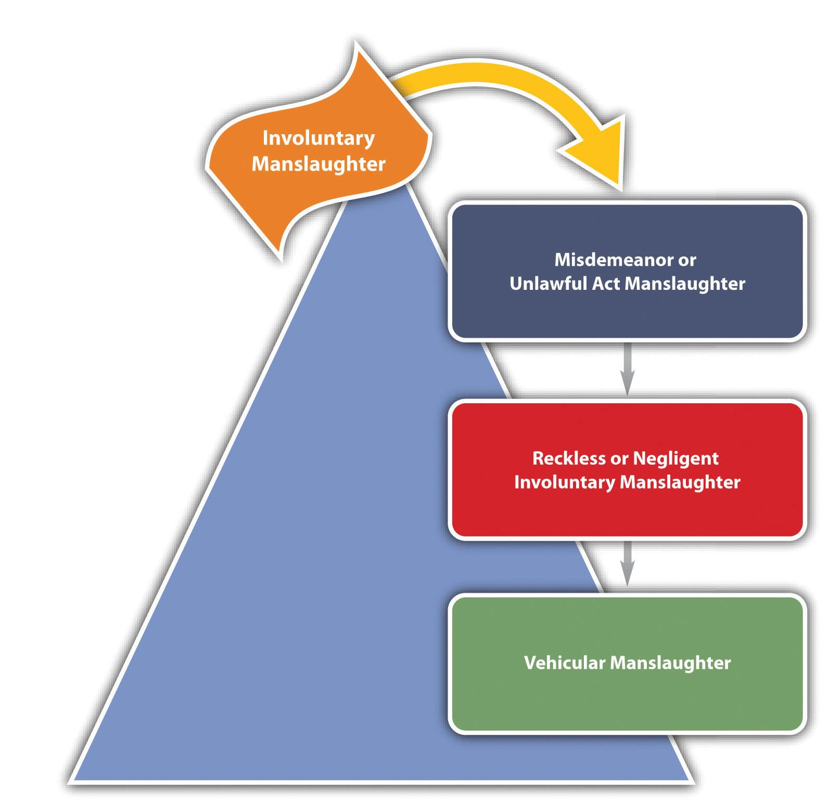
Involuntary Manslaughter
An unintentional killing that results from recklessness or criminal negligence.
The sentence can be more serious if it was caused by an illegal act, even if it had no intent of killing.

Slide 6
Obstruction of Justice
In any way hindering the discovery or conviction of anyone person who has committed a crime.
This can include bribery, murder, intimidation, or use of physical force against a witness.

Slide 7
Murder
The illegal killing of another person with malice aforethought.
Different from manslaughter because must involve the serious intent to kill or cause harm before the crime is committed.

Slide 8
Warrant
A written order by the court that states that the law officials involved may invade on one’s personal rights in order to further a case.
Can include search warrants, arrest warrants, etc.

Slide 9
Allegedly
An unproved accusation causing the one targeted to be under investigation.
One accused of a crime such as burglary would become known as an alleged burglar.
Once proven it becomes an accusation.

Slide 10
Evidence
Any type of proof of a crime being committed that is legally presented at trial.
Circumstantial evidence which requires inference in order to connect it to the crime would be treated much differently than direct evidence of a crime being committed.
There is statistical evidence, testimonial evidence, anecdotal evidence, and analogical evidence.

Slide 11
Circumstantial Evidence
Evidence of a crime being committed legally presented at trial which requires inference to connect it to the crime committed.
Unless connection is too weak it is generally accepted in most cases.

Slide 12
Hard (direct) Evidence
Evidence of a crime being committed legally presented at trial that has a proven direct connection to the crime being prevented that can prove that the one the evidence is used against is guilty of the crime accused.

Slide 13
Trajectory
The path of a body or projectile as it moves through space
Can also mean the path one is committing to in carrying out their life choices.
In both cases is an assumed path something has taken is taking or will take.

Slide 14
Ballistics
Study of flight, behavior, and characteristics of a projectile, especially bullets.
Can be used to determine angle and firing point of a bullet making it useful in the solving of a crime.

Slide 15
Impede
To delay or prevent an event from occurring.
Impeding a case's progression would be known as obstruction of justice and is known as a serious crime.
On the other hand, impeding a crime from being committed would be encouraged.

Slide 16
Image Credits
Sandra Sanz--- Accessory Diagram
Brenda Conley--- Conspiracy Diagram
Flatworldknowledge.com--- Types of Homicide Diagram
Open.lib.umn.edu--- Involuntary Manslaughter Diagram

